Slide 1
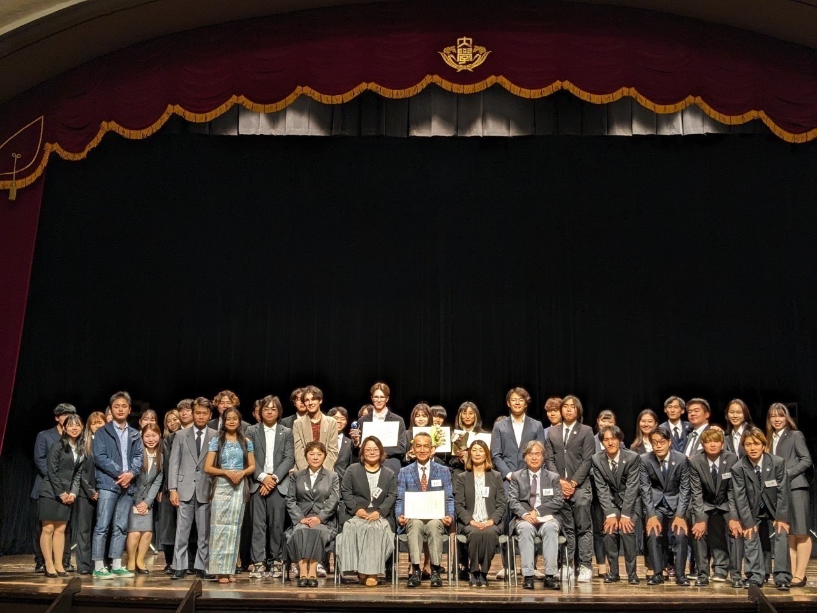
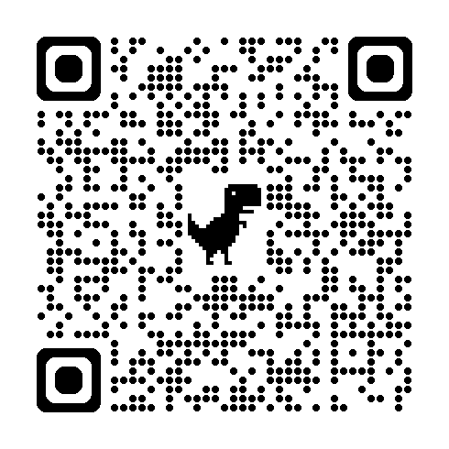
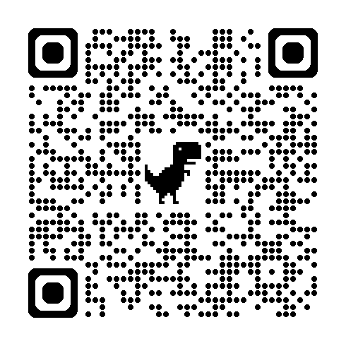
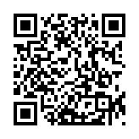
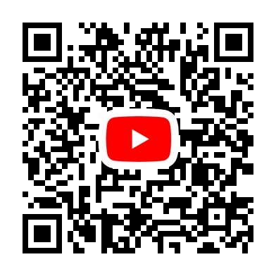
The 59th
Japanese Speech Contest
by International Students
Currently Recruiting Participants!
Application Deadline:
October 4, 2024
December 15, 2024
@Ono Memorial Auditorium
in Waseda University
Reservation of information session
Application for participation
If you have some questions
Contest
Last Year
しゅさい
わせだだいがくこくさいがくせいゆうこうかい
【主催】早稲田大学国際学生友好会(WIC)
HP: https://wicspeechkoutest23.wixsite.com/wic-speechcontest Instagram: @wic1956/ X: @wic_1956

